Slide 1
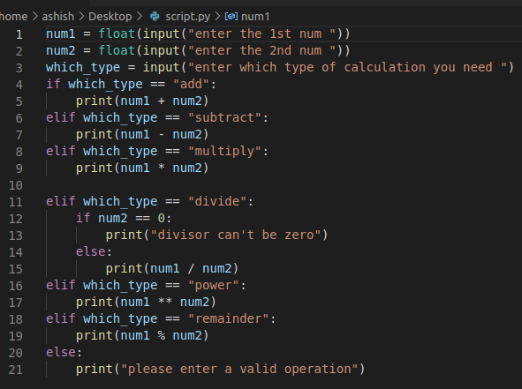
Calculator: We intend to demonstrate simple arithematic operations on numbers
1. How to take to input?
2. Operators:
Assignment operator: Line 1
Equality operator: Line 4
Addition operator: Line 5
Modulo operator: Line 19
3. String comparison

Slide 2
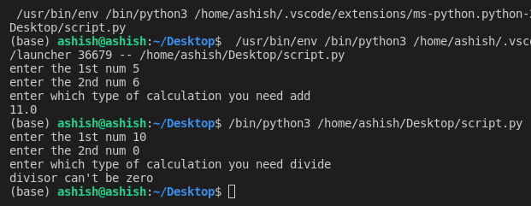
Calculator: Output

